Slide 1
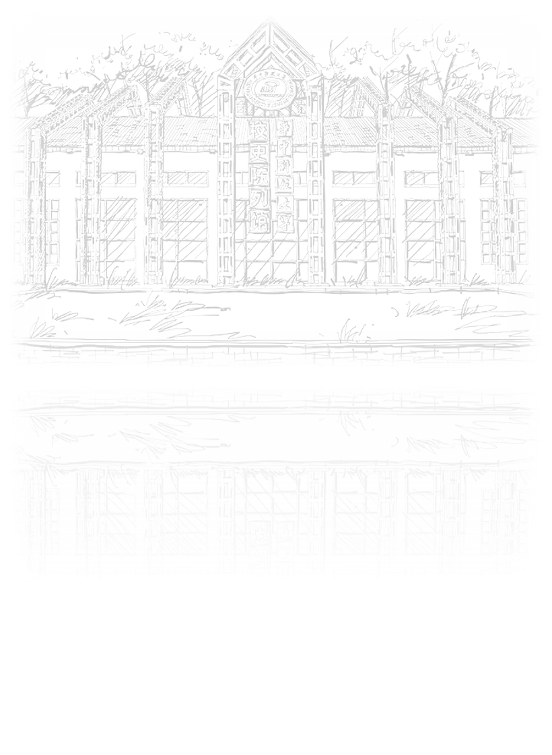
Supporting text here
REPORT
Supporting text here.Supporting text here.
Supporting text here.

Slide 2
CONTENTS
01
02
03
04
Text here
Text here
Text here
Text here
Supporting text here.
Supporting text here.
Supporting text here.
Supporting text here.

Slide 3

01
Text here
Text here
Text here

Slide 4
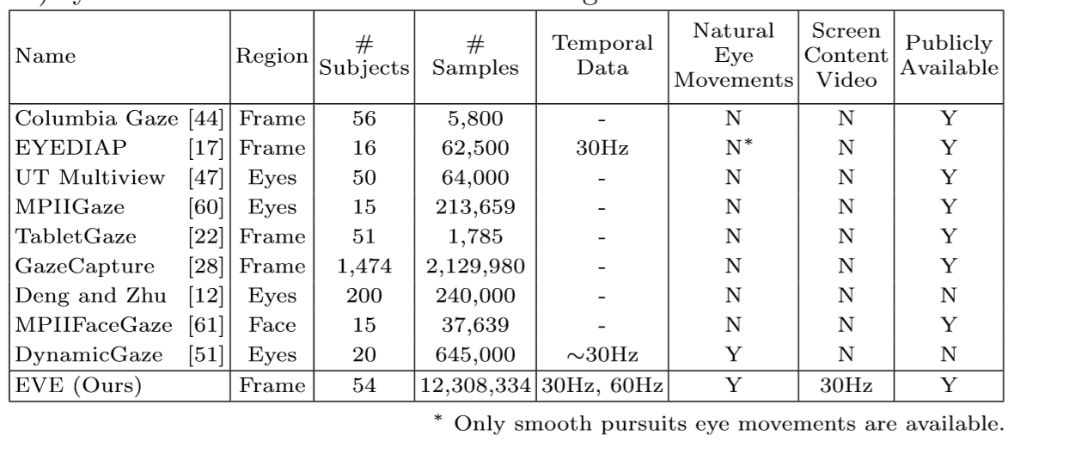
Gaze estimation
dataset

Slide 5
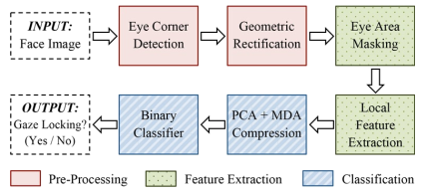
Xucong Zhang
2013 Gaze Locking: Passive Eye Contact Detection forHuman–Object Interaction

Slide 6
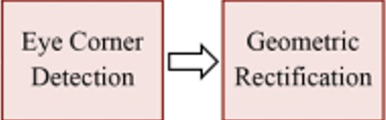
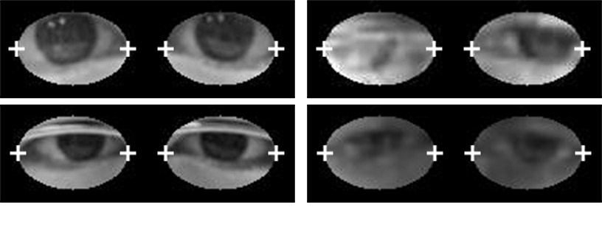
Xucong Zhang
2013 Gaze Locking: Passive Eye Contact Detection forHuman–Object Interaction
第一阶段：预处理阶段
48*36
Notes:
通过商业面部和基准点检测器输出眼角坐标，然后将不同大小的左右眼通过几何变换统一矫正到48*36，两只眼合起来96*36，图像的低分辨率反映了远距离物体。

Slide 7
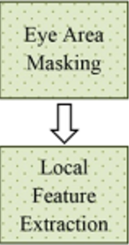
Xucong Zhang
2013 Gaze Locking: Passive Eye Contact Detection forHuman–Object Interaction
第二阶段：特征提取阶段
加入蒙版
Notes:
较大的椭圆型可以显示更多的眼睛周围环境和注视的信息，较小的椭圆形可以减少噪声。 将像素点拼成高维向量，并标准化。

Slide 8
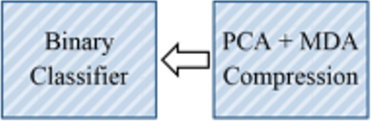
Xucong Zhang
2013 Gaze Locking: Passive Eye Contact Detection forHuman–Object Interaction
第三阶段：分类阶段
Notes:
Pca和mda进行映射，然后svm分类

Slide 9
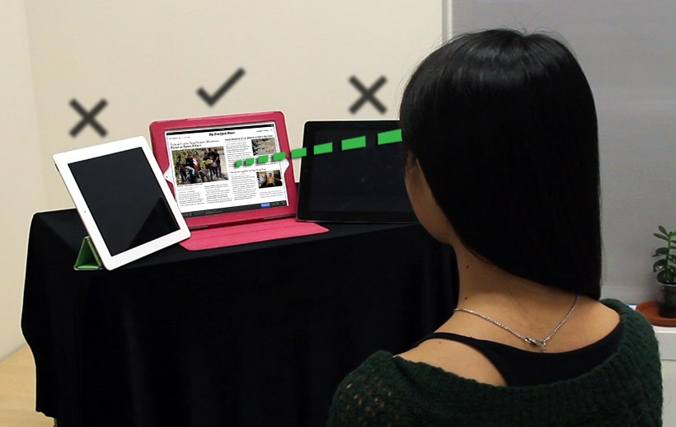
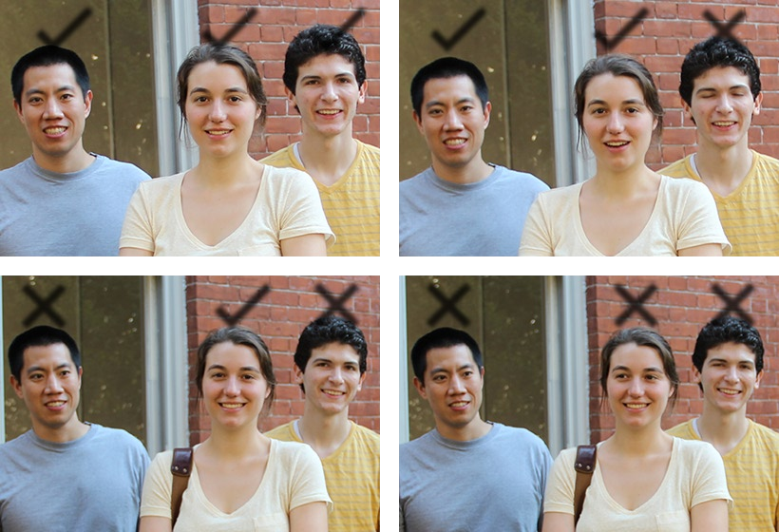
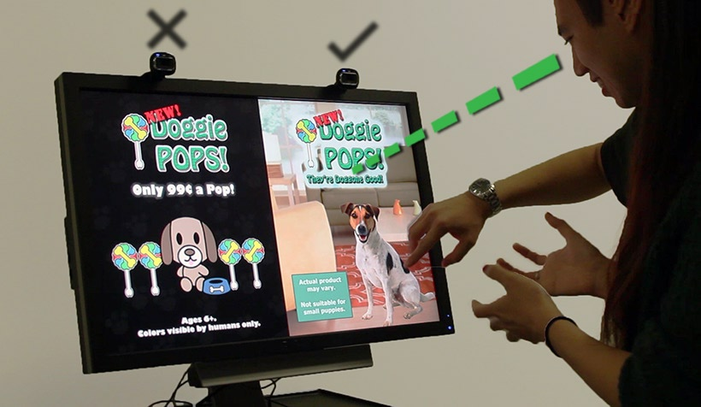
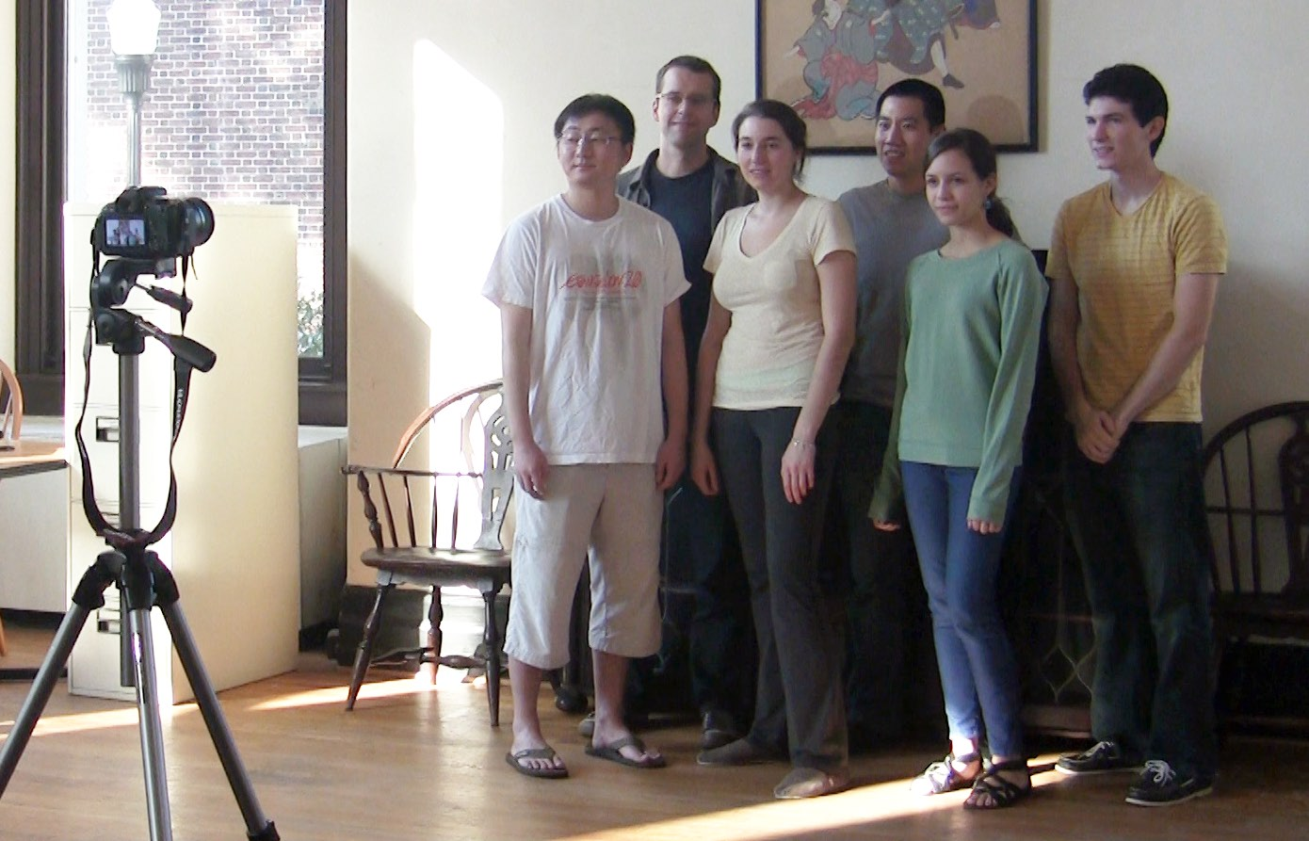
Xucong Zhang
2013 Gaze Locking: Passive Eye Contact Detection forHuman–Object Interaction
Notes:
Pca和mda进行映射，然后svm分类

Slide 10
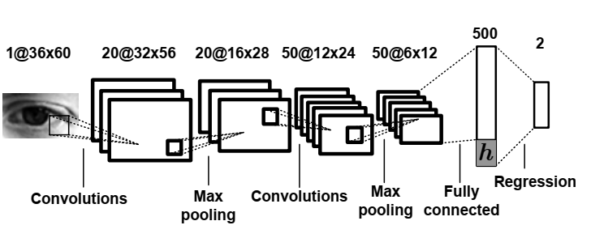
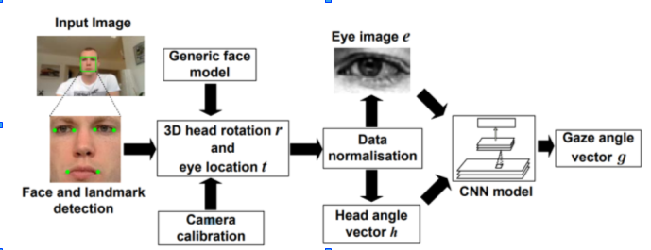
Xucong Zhang
2015 Appearance-Based Gaze Estimation in the Wild

Slide 11
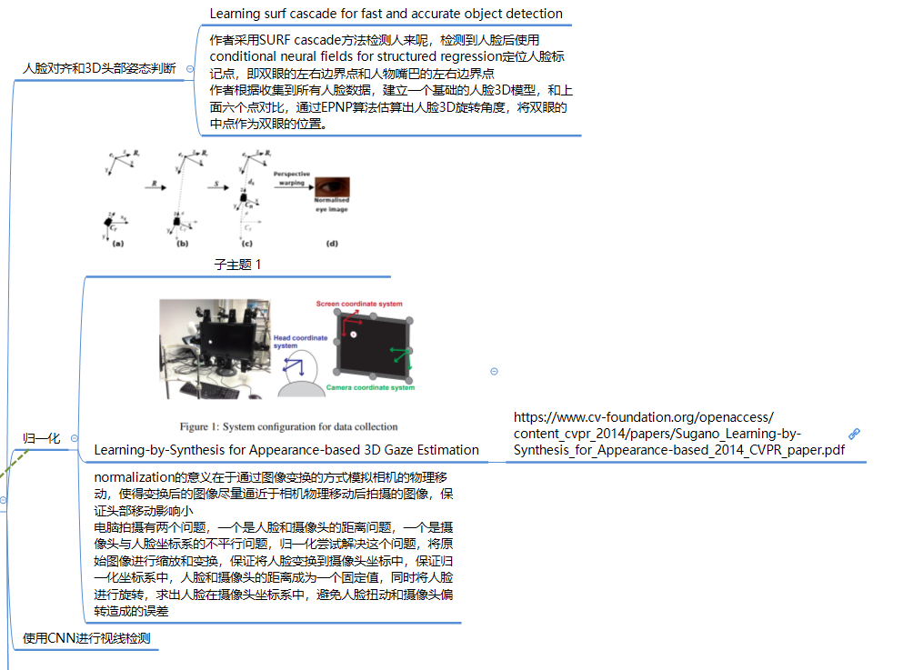
Xucong Zhang
2015 Appearance-Based Gaze Estimation in the Wild

Slide 12
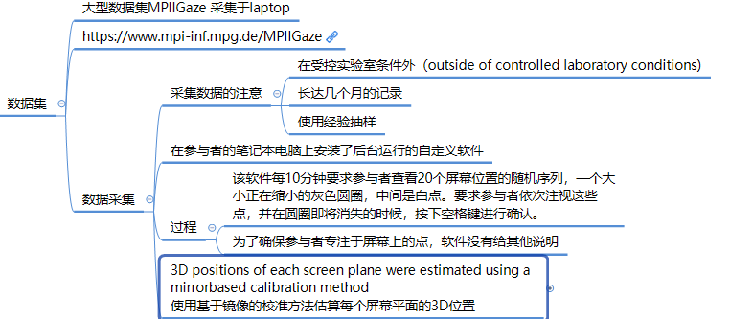
Xucong Zhang
2015 Appearance-Based Gaze Estimation in the Wild

Slide 13
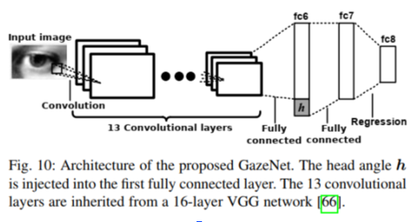
Xucong Zhang
2017 MPIIGaze: Real-World Dataset and Deep Appearance-Based Gaze Estimation
问题：泛化不行，跨数据集性能下降很多

Slide 14
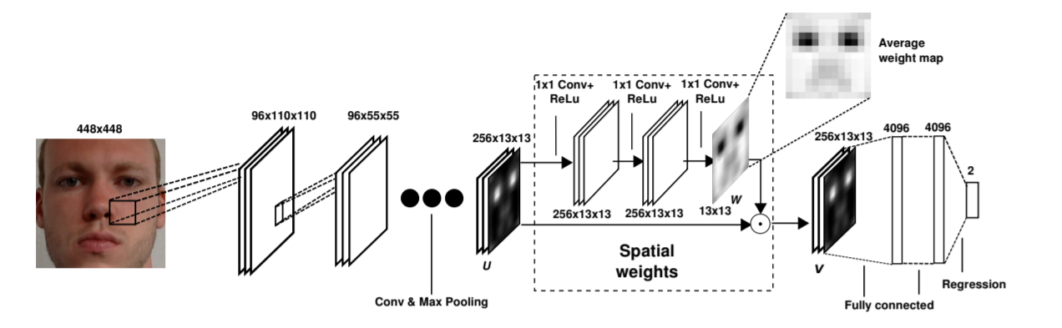
Xucong Zhang
2017 It's written all over your face: Full-face appearance-based gaze estimation
创新：Attention计算权重

Slide 15
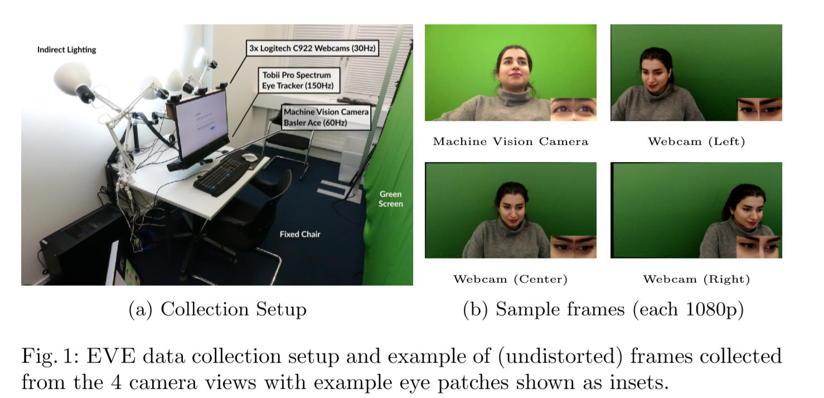
Xucong Zhang
2020 Towards End-to-end Video-based Eye-Tracking

Slide 16
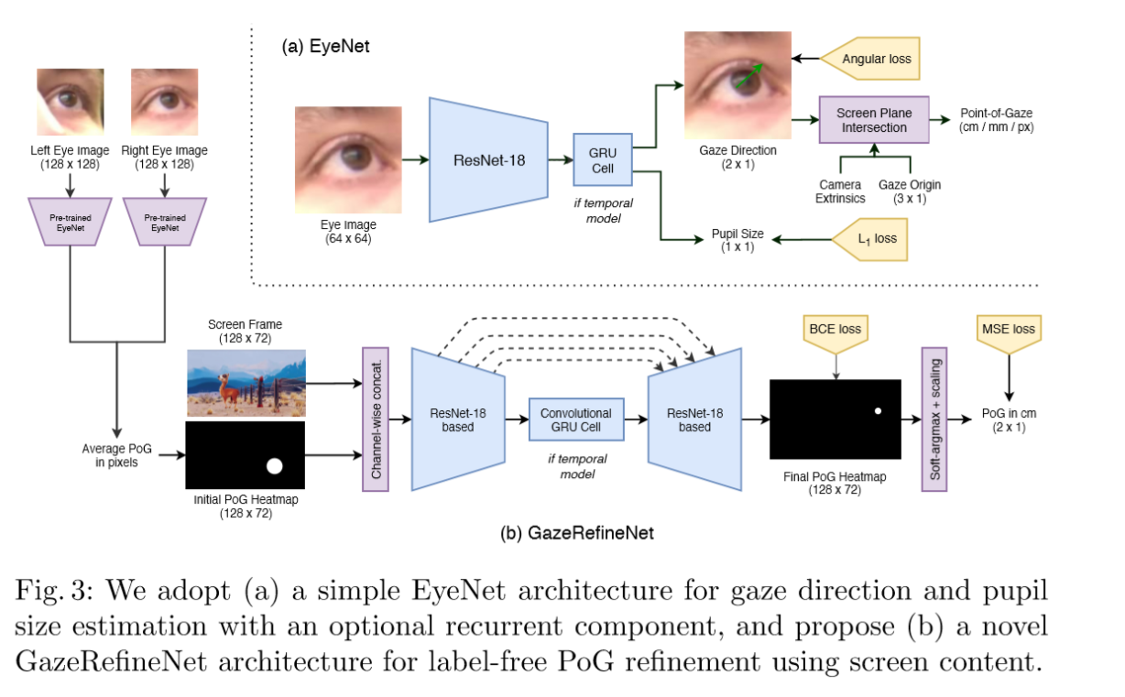
Xucong Zhang
2020 Towards End-to-end Video-based Eye-Tracking
Code和dataset coming soon

Slide 17
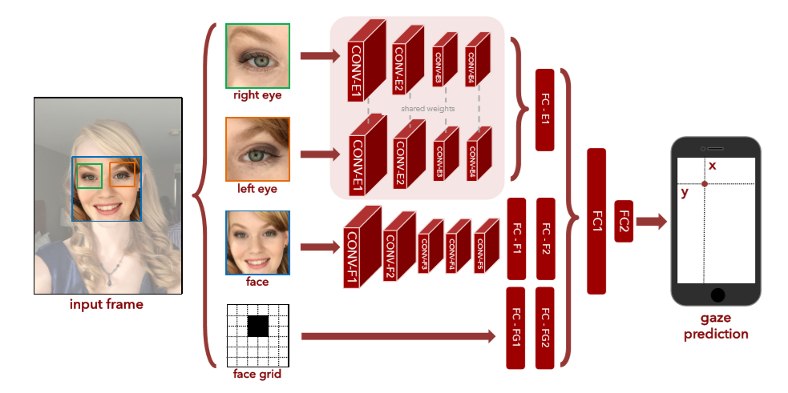
手机端

Slide 18
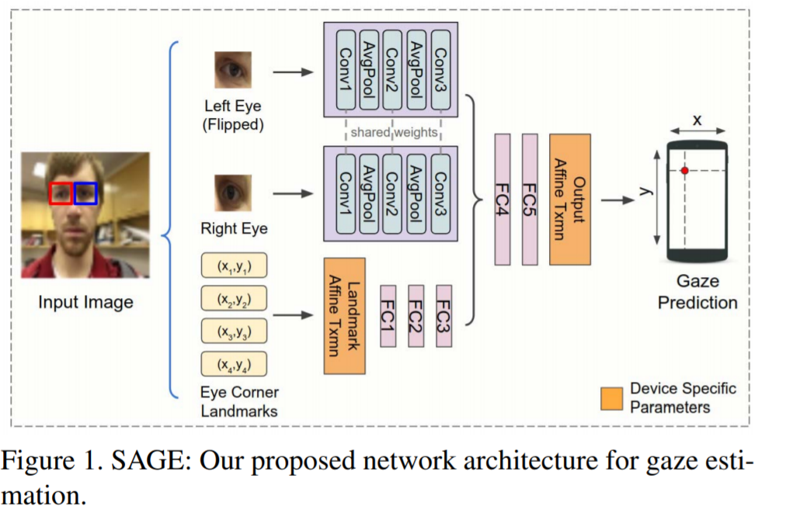
手机端
Google对上述模型做了进一步压缩，即将人脸和人脸位置这两个输入替换为四个眼角的位置坐标

Slide 19
Xucong Zhang
1.数据集收集困难
2.数据集的标注本身有问题，影响了正确率的提升
3.泛化能力差，不同数据集上效果不同

Slide 20
Xucong Zhang
数据集收集困难
使用GAN合成眼部数据。微软剑桥研究院的Erroll Wood博士在读博期间曾尝试使用计算机图形学的方法来合成眼睛样本[1]，并公开了相关数据集。其中UnityEyes数据集因其真实性及丰富的标签信息（关键点位置）已经是gaze领域十分重要的数据集。
[1] Wood, E., Baltrušaitis, T., Morency, L.-P., Robinson, P., and Bulling, A. (2016b). Learning an appearance-based gaze estimator from one million synthesised images. In Proceedings of the Ninth Biennial ACM Symposium on Eye Tracking Research & Applications (ETRA), pages 131–138.

Slide 21
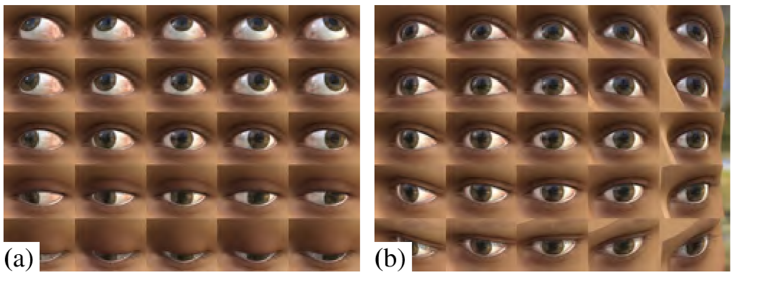
Xucong Zhang
UnityEyes

Slide 22
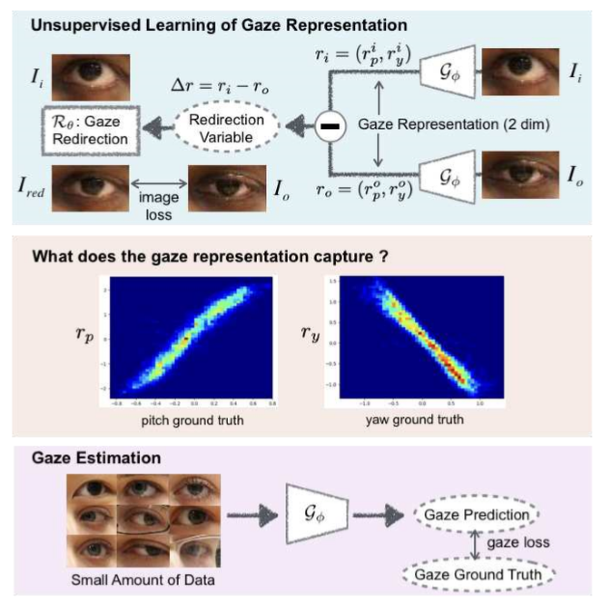
Idiap
2020 Unsupervised Representation Learning for Gaze Estimation

